Slide 1
Online Reviews
Henry Otuadinma
11th April, 2019

Slide 2
What?
Feelings expressed by customers about a product/service
Online reviews:
Are the biggest source of social proof
Make a business More Visible
Make a business Look Trustworthy
Expand the Conversation About a business

Slide 3
Why should I care?
Vital for survival of businesses especially SMEs and start-ups

Slide 4
Highlights
97% of Consumers Read Online Reviews
88% of consumers trust online reviews
Online reviews incredibly impact consumer behaviour
Initially done mainly on websites like Yelp, TripAdvisor, etc.
Non-review and Social platforms are growing stronger as online review sources
Consumers expect responses from businesses especially when they drop negative reviews

Slide 5
Points of interest
How do consumers find and leverage online reviews?
Yelp, Google
How do reviews and ratings impact consumers ’ behaviour?
Responding to negative reviews as a business

Slide 6


How do consumers find and leverage online reviews?
A dedicated website for reviews and ratings since 2004
Had a monthly average of 102 million unique visitors in Q4 2018
Yelpers have written more than 177 million reviews by the end of Q4 2018
45% of consumers are likely to check reviews on Yelp before visiting a business
About 80% of Yelpers visit the platform because they intend to make a purchase
Not devoid of controversies

Slide 7


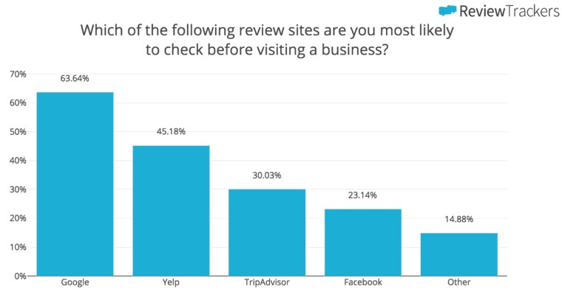
How do consumers find and leverage online reviews?

Slide 8
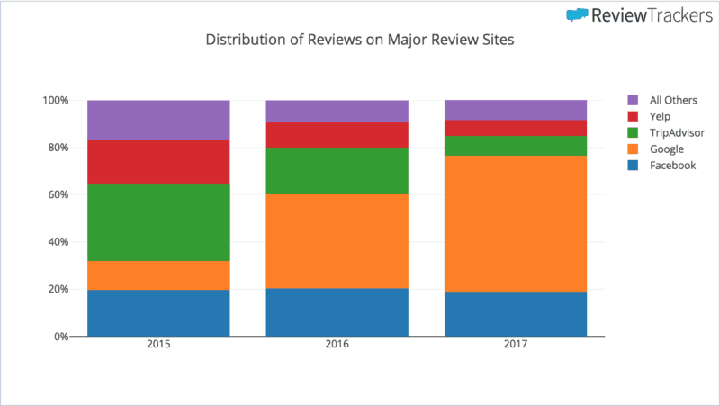
Traditional Non-review sites coming out strong

Slide 9
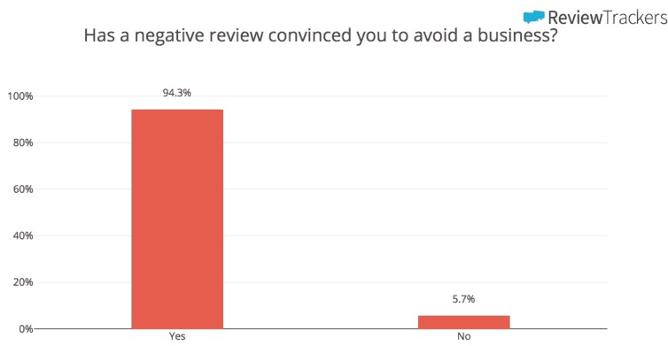
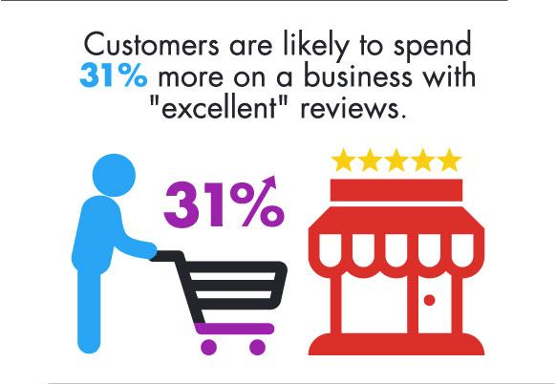
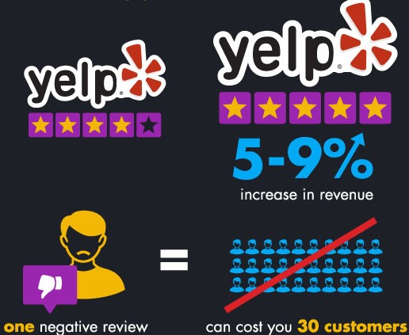
How do reviews and ratings impact consumers’ behaviour?

Slide 10
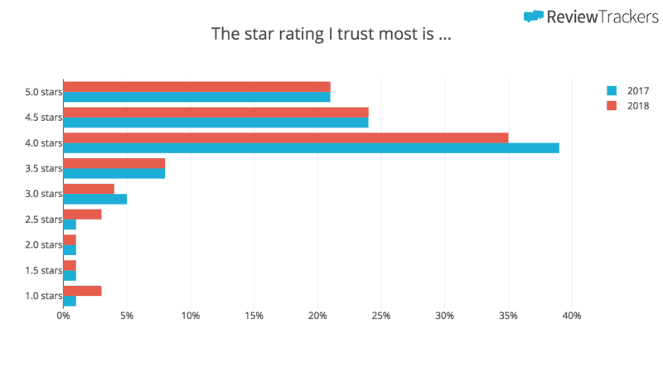
How do reviews and ratings impact consumers’ behaviour?

Slide 11
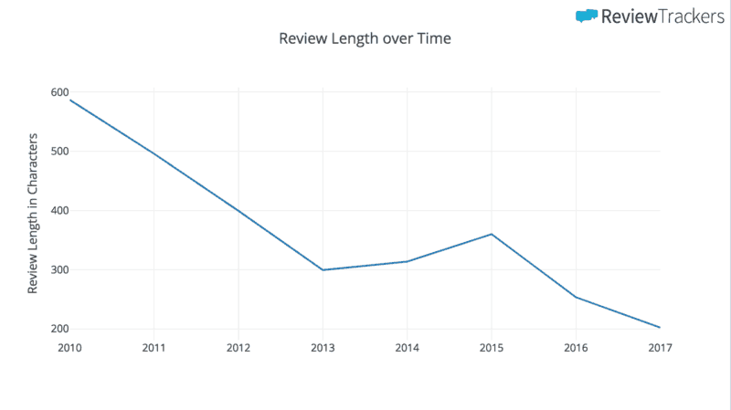
Current trends
Reviews are getting shorter
More positive
More people leave reviews
Google is where the most positive reviews occur

Slide 12
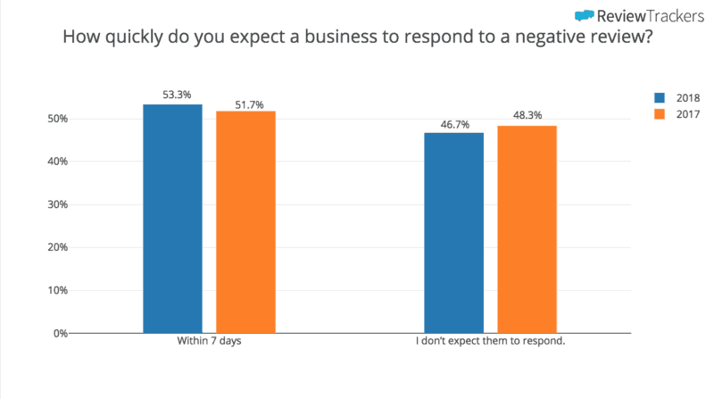
Responding to negative reviews as a business

Slide 13
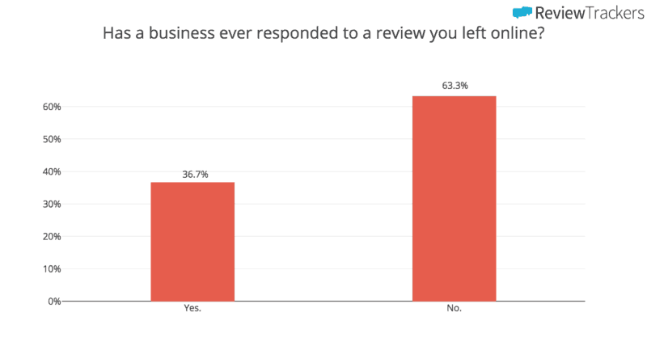
Responding to negative reviews as a business

Slide 14
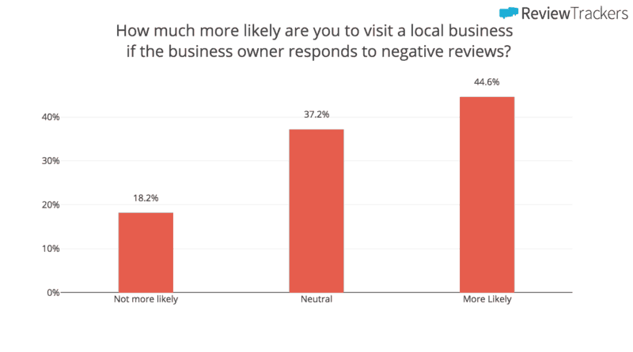
Responding to negative reviews as a business

Slide 15
Conclusion
Customers usually rely on others’ feelings about a product/service to make crucial decisions
Sentiment analysis can be an overkill in some cases
Google has become the predominant review/rating platform
Reviews are becoming more positive and shorter
A shift in customer behavior and the quality of service delivered to customers can lead to more positive reviews
Every business should care about reviews and handle issues head-on

Slide 16
References
https://www.reviewtrackers.com/online-reviews-survey/
https://www.reviewtrackers.com/track-google-reviews/

